Slide 1
Non-uniform patch sampling with deep convolutional neural networks for white matter hyperintensity segmentation
Mohsen Ghafoorian^{a,b}, Nico Karssemeijerª, Inge van Uden^{c}, Frank-Erik de Leeuw^{c}, Tom Heskes^{b}, Elena Marchiori^{b}, Bram van Ginnekenª and Bram Platelª
ª Diagnostic Image Analysis Group, Radiology Department, Radboudumc, Nijmegen, the Netherlands ^{b} Institute for Computing and Information Sciences, Radboud University, Nijmegen, the Netherlands
^{c} Donders Institute for Brain, Cognition and Behaviour, Department of Neurology, Radboudumc, Nijmegen, the Netherlands

Slide 2
White Matter Hyperintensities
Areas of demyelinated cells in WM, hyperintensities in FLAIR
Appear as Common finding on MR images of patients:
Small Vessel Disease
Multiple sclerosis
Alzheimer’s disease
Stroke

Slide 3
Patch based segmentation
Notes:
CNNs are originally designed for image classification. A popular way to reduce the segmentation problem is to have a sliding window going all over the image and classify all of the voxels given a local neighborhood of that.

Slide 4
Simple model:
Convolutional
Layers
300
200
Softmax
2
Convolutional Layers
Convolution
Convolution
Convolution
Convolution
20
3
18
32
26
22
3
3
5
3
20
18
7
5
22
80
110
26
32
7
40
20
Notes:
We can start to design a simple CNN model to train on the patches with a number of convolutional and fully connected layers.

Slide 5
A problem!
-
+
Notes:
However if we follow this simple model, we would likely face a problem: Just consider your self to be a well-trained CNN on millions of patches and say at the test time you are given such a patch and you queried with label for the central voxel: your response would depend on how you imagine the situation:
You might imagine that this patch is coming from the cortical area and consider the bright central voxel as the gray matter and not WMHs.
You could alternatively imagine that this patch is coming from the ventricular area where it is very likely to see WMHs and consider this as a WMH.
One easy solution you might think of, is to increase the patch size. We can then discriminate this case very easily. But this is not a very good idea and I will tell you why:

Slide 6
Larger scales!
+
-
Notes:
Consider a voxel belonging to WMHs in the border of a lesion, something like the one we see here; this taking a large context from the neighborhood results in a patch like this, but if we go just one voxel to the right, where we have a normal appearing white matter voxel, we will get this patch is hardly any different visually. And our deep learning system or in general any other visual recognition system will have a hard time to accurately localize the structure in the center of the patch. So there is indeed a trade between the localization accuracy and the amount of context information captured by our patch.

Slide 7
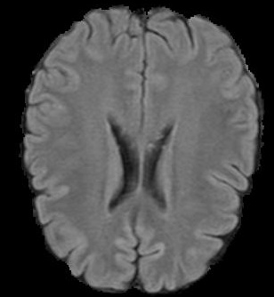
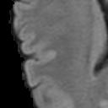
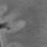
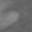
Solution1: Multi-scale patches
FLAIR
T1
S₁
S₂
S₃
Notes:
One solution then would be to feed the network with different scales where the network can find the fine details from the smallest scale and a general contextual information from the larger scales

Slide 8
Models: Multi-scale Early Fusion (MSEF)
Convolutional
Layers
300
200
2
Softmax
s₂
s₃
s₁
Notes:
And of course we have to think about how to feed the network with the multiscale patches. We can simply stack the different patches in the input layer of the network if we downsample the larger scales to have the same size as the smallest scale.

Slide 9
Models: Multi-scale Late Fusion (MSLF)
S₁
Convolutional
Layers
300
S₂
Convolutional
Layers
300
200
2
Softmax
S₃
Convolutional
Layers
300
300
Notes:
Or alternatively we can feed each of scales to different convolutional layers and later on combine the descriptive features coming from the different streams.

Slide 10
Disadvantages of the multi-scale approach
More redundant samples from the image
More computationally expensive
Too many degrees of freedom!
Notes:
However there are still a few downsides for the multiscale approach: we are getting and processing redundant information in our patches and therefore both the training and segmentation would be more computationally expensive and also we are imposing new design choices: how many scales, how large should each scale be, how are we going to fuse this information, etc.

Slide 11

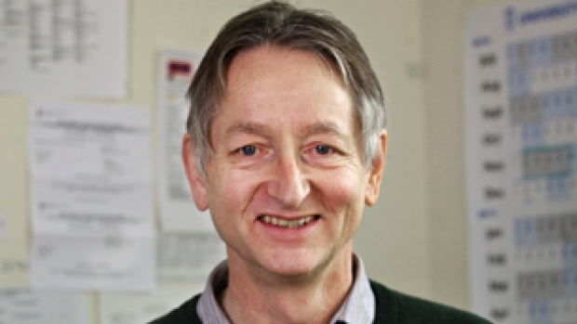
Most of the work is in deciding what not to look at!
“Vision for us is a sampling process, where
you have this high resolution area and you
are deciding where to put it.”
Geoffrey Hinton
Notes:
But looking back at how our natural vision works, it works differently! At the time that I am looking at Bram’s face, I am getting a lot of details: I can clearly see if he smiles, or blinks. I get these details because maybe I have decided to collect more data from this particular region from the outside world! However I still see other people but with less detail. So I am getting some sort of contextual information that can be also important. For example if at the same time that I am looking at Bram, Babak makes an abrupt move that might threaten my life I can easily capture that! Geoffery Hinton somewhere says: “…..” and this is not the main direction that the main stream of vision moves toward.
Coming back to our problem, normally people uniformly sample the patches around the point of interest. This is an unnecessary assumption we want to break. Therefore in this study we try to get more details from the central part of image, where the details matter the most, and decrease the sampling rate as we get farther away from the center where we want undetailed contextual information.

Slide 12
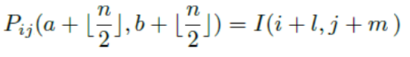
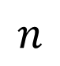
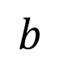
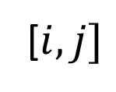
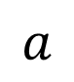
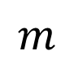
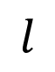
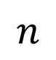
Non-uniform patch sampling
Patch
Image
$$n$$
$$b$$
$$a$$
$$m$$
[$i, j]$
$$l$$
$$n$$
Notes:
Assume we want to non-uniformly create an nxn patch around the pixel coordinate [I, j] of an image: and we want to find the corresponding location in the Image to sample for a pixel with offset a, b from the center of patch (where the corresponding offsets are l and m on the original image)
With uniform sampling people set l=a and m=b.
We compute l and m with the following equation. One way to interpret this is: squared root of a2 plus b2 shows the distance the location that we want to sample from the center of the patch and we are exponentially increasing this distance to find the corresponding location in the image. Alpha is a factor controlling this exponential growth. If you set alpha to 0 it will be equal we have b times e to the power of 0 and it will be using normal uniform sampling.
The larger the faster the sampling rate decreases as go farther away from the center of the patch.

Slide 13
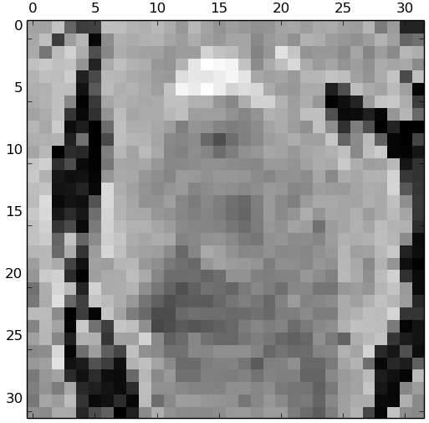
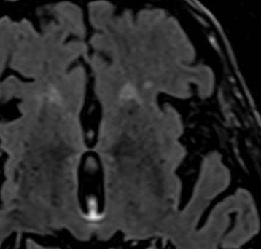
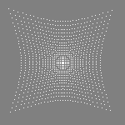
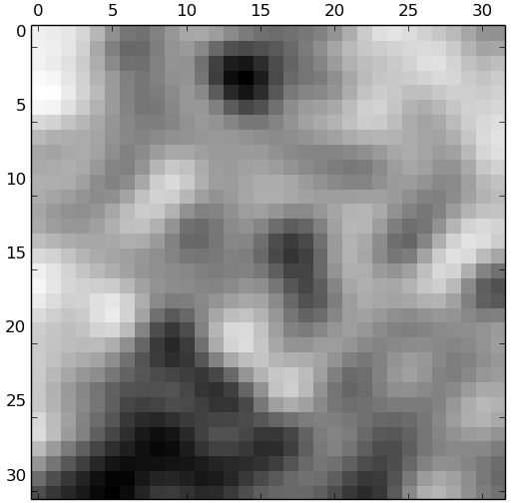
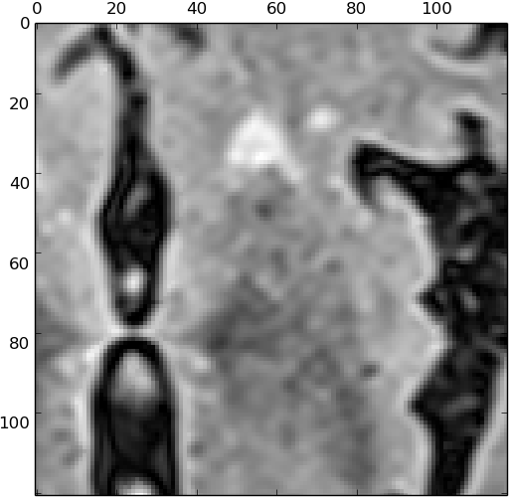
Non-uniform patch sampling
Non-uniform
32x32 patch
Uniform patch
same size
Uniform patch
same extent
Notes:
In this image we see how we get samples for the patches from a specific location indicated by brighter dots.
Here this is the result of sampling a non-uniform 32x32 patch with alpha equal to 0.02
Below we see how the sample looks like if from the same center we get the same number of samples (we see that it does not capture much contextual information
The patch on the right is sample from the same center, covering almost the same extent with uniform sampling. This is indeed roughly 120*120. so getting roughtly 16 times more samples.

Slide 14
Comparison Architectures
Convolutional Layers
CNN Architectures
Convolution
Convolution
SS:
Convolution
Convolution
S₁
Convolutional
Layers
300
200
Softmax
2
20
18
32
22
3
MSEF:
26
3
Convolutional
Layers
300
3
200
Softmax
3
18
2
5
20
22
110
s₁
s₂
7
26
5
80
s₃
32
7
40
S₁
Convolutional
Layers
300
20
MSLF:
S₂
Convolutional
Layers
300
200
2
Softmax
S₃
Convolutional
Layers
300
Notes:
To investigate the effectiveness of our approach we trained single scale and multi-scale architectures with uniform sampling and compare it to non-uniform sampling trained only on a simple single single-scale architecture. All of the other learning ingredients are kept to be the same on these experiments

Slide 15
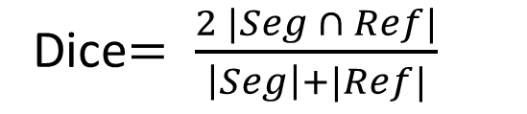
Results
Seg
Ref
Dice$= \frac{2 |Seg ∩ Ref|}{\left|Seg\right|+|Ref|}$
✓
Notes:
Here comes the results: first we cross-validated to find the best value for alpha as the only sampling parameter: and it turns out that alpha=0.02 is the best value for it.
In table 2: we compare the Dice score and Az of the methods and as the results show a single-scale architecture with non-uniform patches substantially outperforms the counterpart with uniform patches. This holds also for early fusion multiscale. And it is even slightly better than the late fusion architecture. And perform close to the human experts.
Computing the p-values shows the same trends. Although NUSS is not significantly better thatn UMSLF, but in majority of the bootstraps it performed better.

Slide 16
Qualitative Results
FLAIR
Reader1
Reader2
Proposed

Slide 17
Qualitative Results
FLAIR
Reader1
Reader2
Proposed
Notes:
Here we can quantitatively see the segmentation results compared to the two available human readers.

Slide 18
Discussion and Conclusions
Advantages of non-uniform patch sampling:
Stronger ties with natural vision
Less hyper-parameters to tune, less complexity
Takes less samples from the image
Cheaper to compute
Non-uniform patch sampling with a simple SS architecture can be:
Significantly better than uniformly sampled SS and MSEF
Slightly better than uniformly sampled MSLF

Slide 19
Thanks!

Slide 20
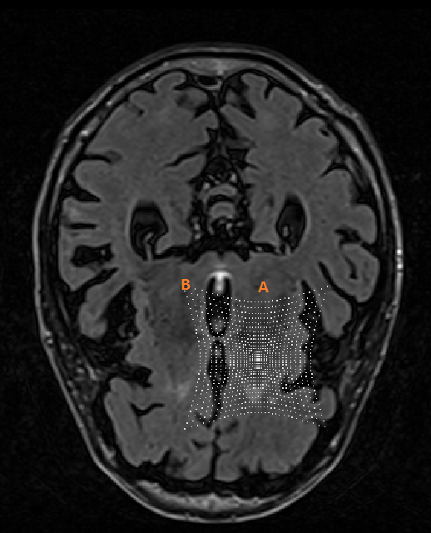
Further discussion – An anomaly!

Slide 21
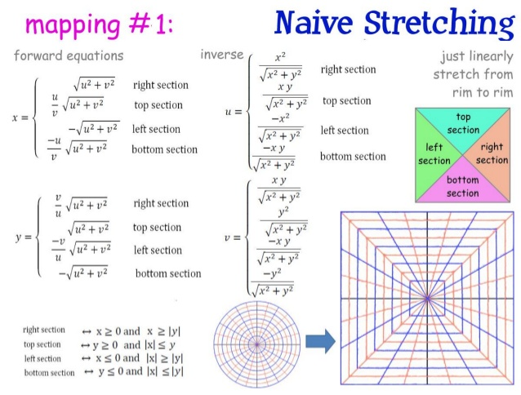
Further discussion – An anomaly

Slide 22
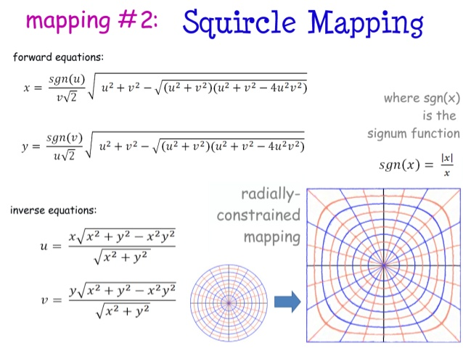
Further discussion – An anomaly

Slide 23
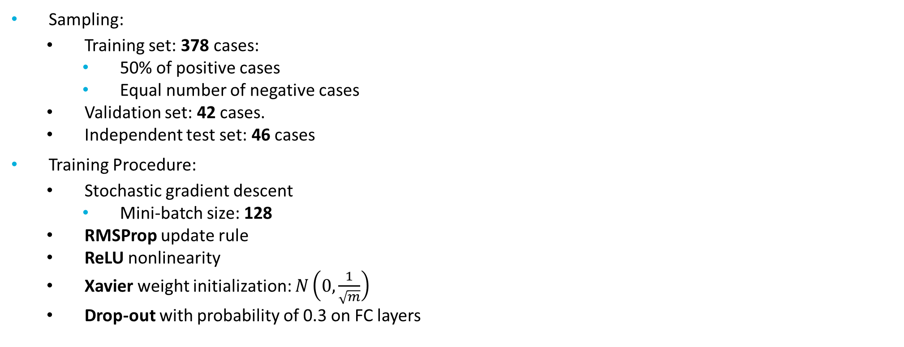
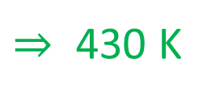
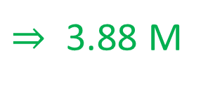
Training details
Sampling:
Training set: 378 cases:
50% of positive cases
Equal number of negative cases
Validation set: 42 cases.
Independent test set: 46 cases
Training Procedure:
Stochastic gradient descent
Mini-batch size: 128
RMSProp update rule
ReLU nonlinearity
Xavier weight initialization: $N\left(0,\frac{1}{\sqrt{m}}\right)$
Drop-out with probability of 0.3 on FC layers
3.88 M
430 K
Notes:
Before going to the results, I need to mention some details regarding our sampling and training procedures:
We use 378, 42 and 46 images for training, validation and testing porpuses. We randomly pick 50% of the voxels from the lesions as positive and an equal number of negative samples, to form a balanced dataset. This resulted in a training set of roughly 4 millions samples and a validation set of 430 K samples, which are big enough for a decent training and validation.
We use the stochastic gradient boosint algorithm to train our network with minibach

Slide 24
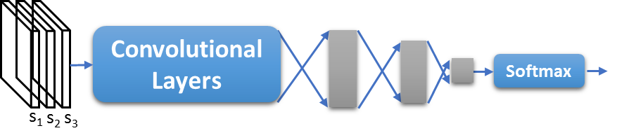
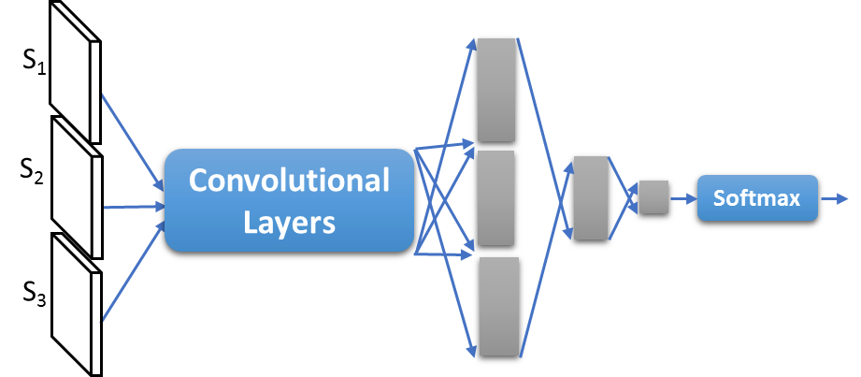
Further discussion: Early fusion vs late fusion
s₁
s₂
s₃

